Slide 1


EPS: Electrical Power Subsystem

Slide 2

TABLE OF CONTENTS
01
02
03
04
INTRODUCTION
SOFTWARE STATIC
DESIGN
What is EPS
& What it does
EPS main task , modules
& parameters
SOFTWARE DYNAMIC
DESIGN
HARDWARE DESIGN
Scheduler sequence
& timeline
Components & PCBs

Slide 3

01
INTRO
1.What is EPS
2.EPS Responsibilitie

Slide 4

What is EPS
The Electrical Power Subsystem (EPS) is responsible for:
Subsystems power management(Voltage & Current Monitoring).
Batteries temperature control.
Charging the batteries from the solar panels using the MPPT technique.

Slide 5
02
STATIC SOFTWARE DESIGN

Slide 6
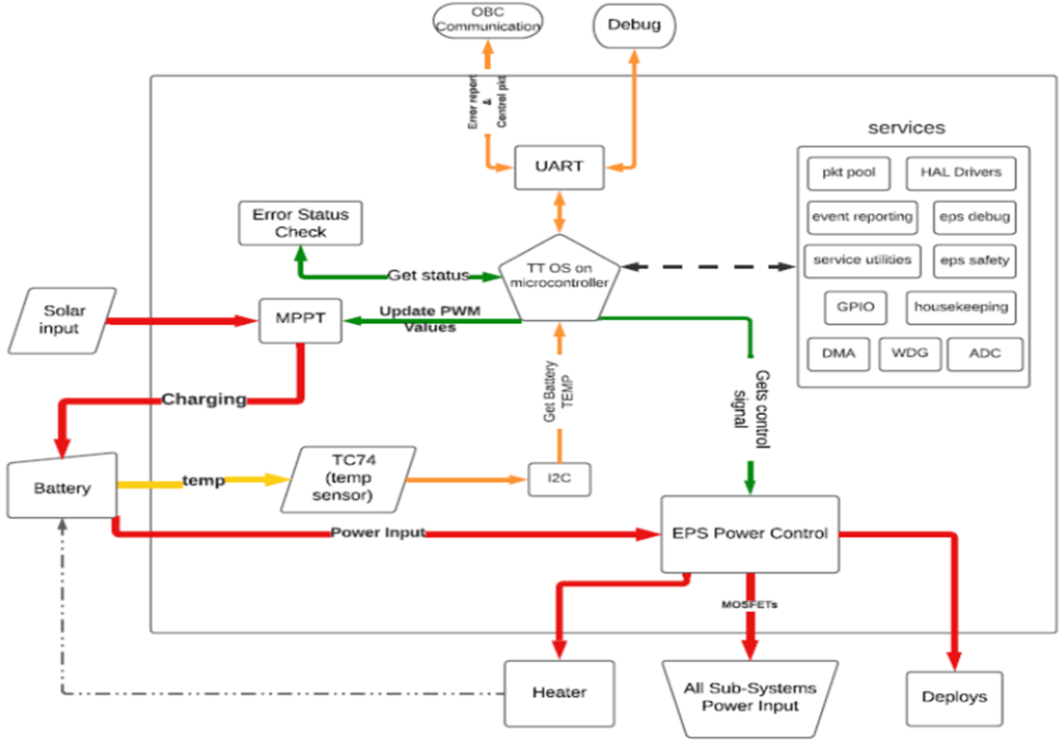
STATIC SOFTWARE DESIGN BLOCK DIAGRAM

Slide 7
03
DYNAMIC SOFTWARE DESIGN
1.TASKS SCHEDULING
2.TIMELINE OF EXECUTION

Slide 8
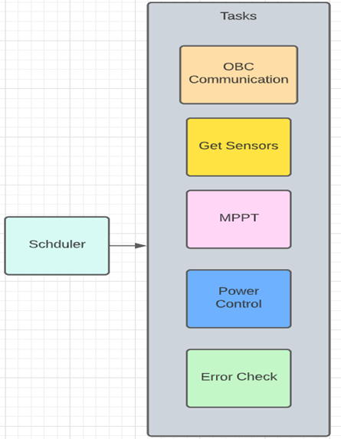
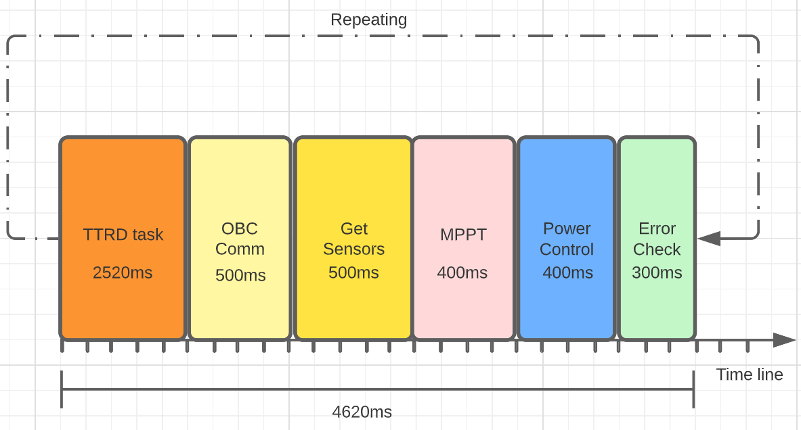
DYNAMIC SOFTWARE DESIGN BLOCK DIAGRAM

Slide 9
04
HARDWARE DESIGN
1.Solar Panels
2. Batteries
3.Power Distribution and Management
4.Microcontroller
5. PCB Design

Slide 10
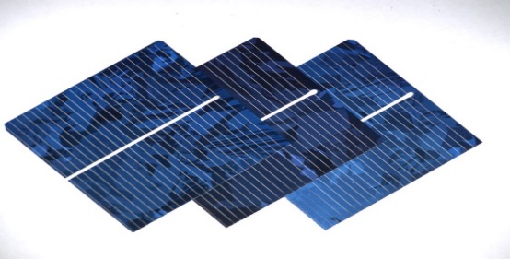
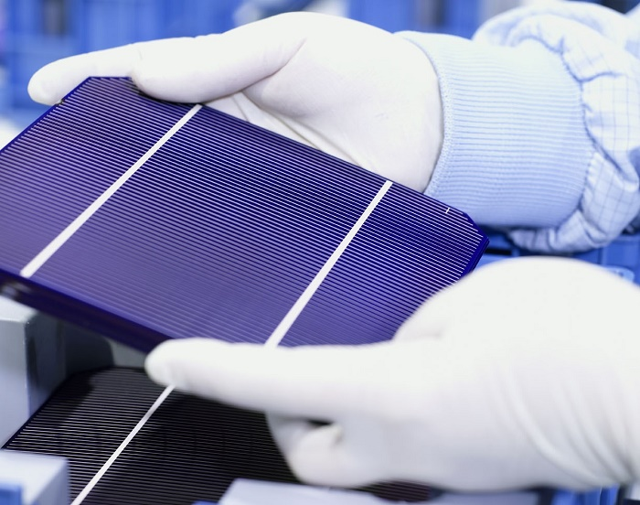
SOLAR PANELS

Slide 11


Slide 12
2.BATTERISE
 | Lithium polymer | Lithium ion
Chemical reaction | Varies, depending on electrolyte. | Varies, depending on electrolyte.
Operating temperature | Improved performance at low and high temperatures. | 4º F to 140º F ( -20º C to 60º C)
Recommended for | Cellular telephones, mobile computing devices. | Cellular telephones, mobile computing devices.
Initial voltage | 3.6 & 7.2 | 3.6 & 7.2
Discharge rate | Flat | Flat
Charging temperature | 32º F to 140º F (0º C to 60º C) | 32º F to 140º F (0º C to 60º C)
Storage lite | Loses less than 0.1% per month. | Loses less than 0.1% per month.
Storage temperature | -4º F to 140º F ( -20º C to 60º C) | -4º F to 140º F ( -20º C to 60º C)
Notes | - Typically designed to be recharged in the device rather than in an external charger. - Lighter than nickel-based secondary batteries with (Ni-Cd and NiMH). - Can be made in a variety of shapes. | - Typically designed to be recharged in the device rather than in an external charger. - The chemical construction of this battery limits it to a rectangular shape.

Slide 13
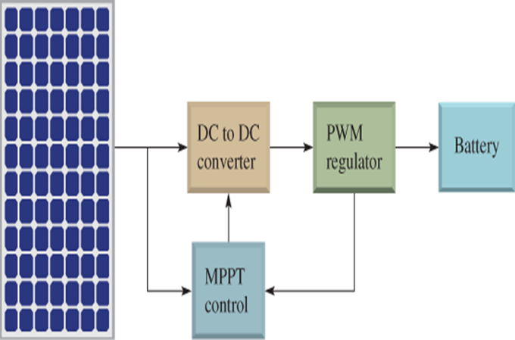
POWER DISTRIBUTION

Slide 14
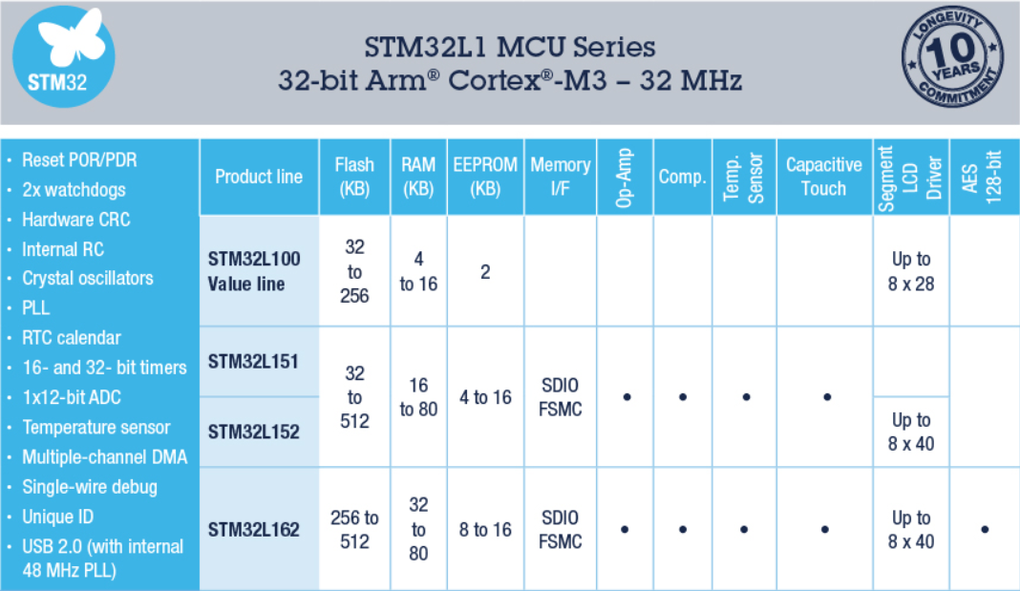
MICROCONTROLLER
ST ULTRA-LOW POWER (L FAMILY)

Slide 15
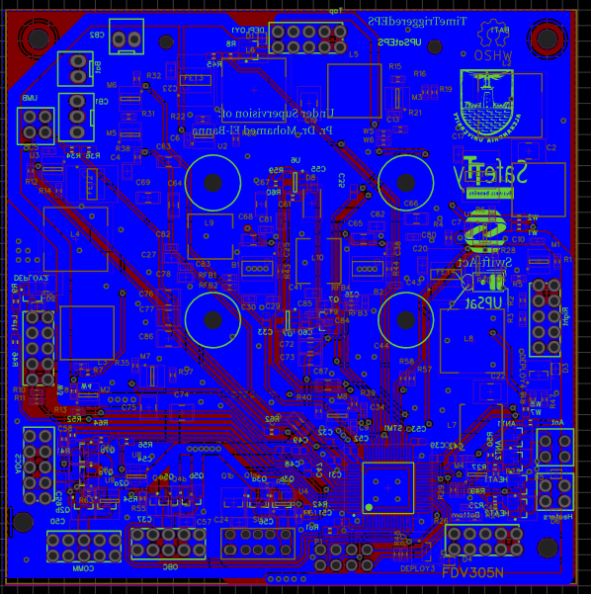
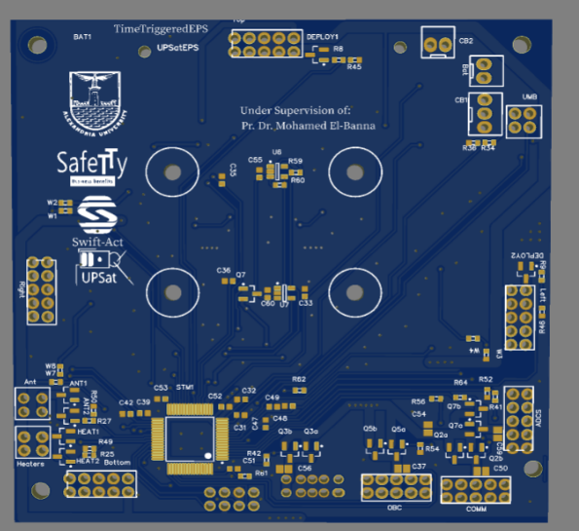
PCB DESIGN

Slide 16
Hardware Implementation

Slide 17


Slide 18
CONTENTS
01
02
03
04
Hardware Design Process
Suppliers & Shipping
Testing & Troubleshooting
Fabrication & Assembly

Slide 19
01
Hardware Design Process
Hardware Design Workflow

Slide 20
Hardware Design PROCESS
01
02
03
04
Specifications
Design
PCB
Testing
Problem Statement & Requirements
Concepts & Schematics
Layout
Fabrication
Assembly
Hardware Test
System Test
Minimization

Slide 21
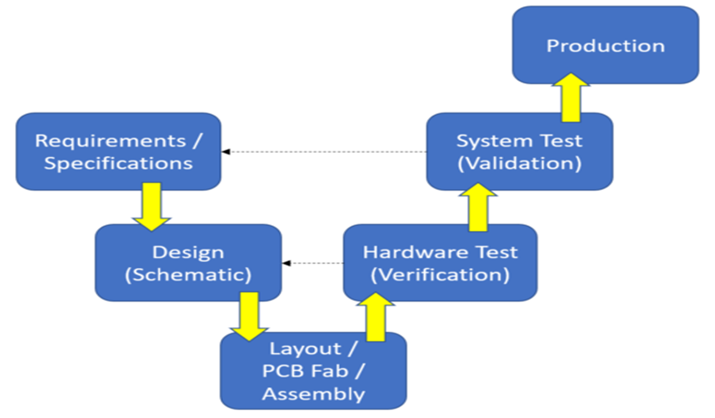
Hardware Design Workflow:

Slide 22
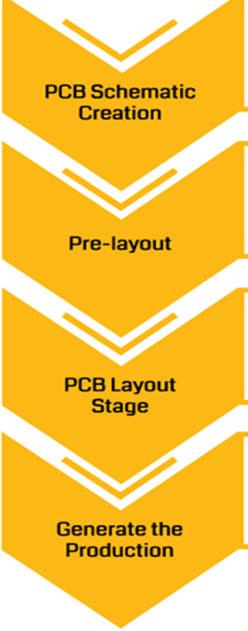
PCB Design Process

Slide 23


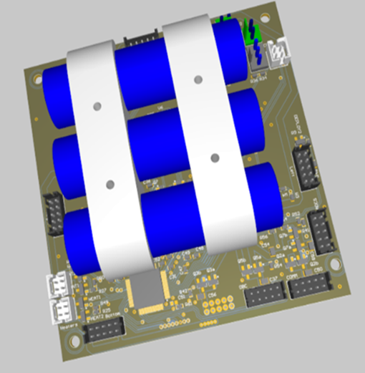
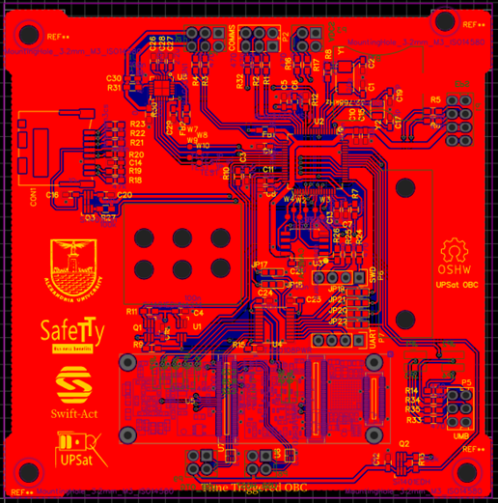
Hardware Design Tools

Slide 24
02
Suppliers & Shipping

Slide 25




Suppliers & Shipping

Slide 26
03
Fabrication & Assembly

Slide 27



Fabrication & Assembly

Slide 28
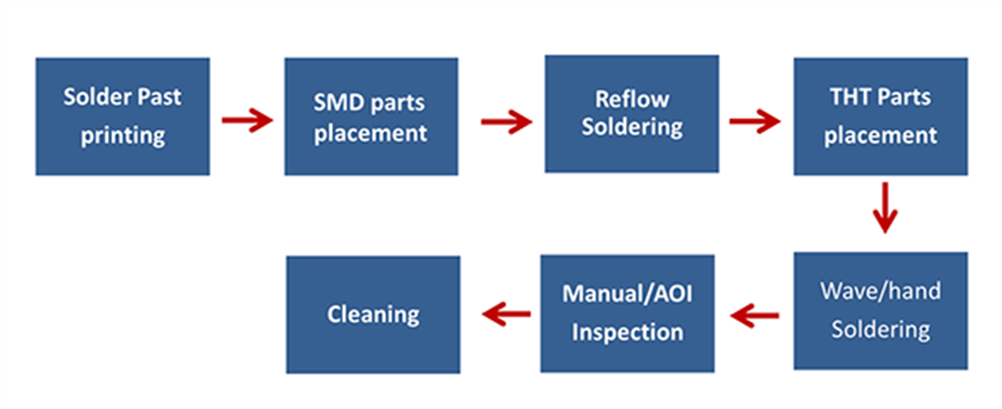
Assembly Process

Slide 29
04
Testing & Troubleshooting

Slide 30
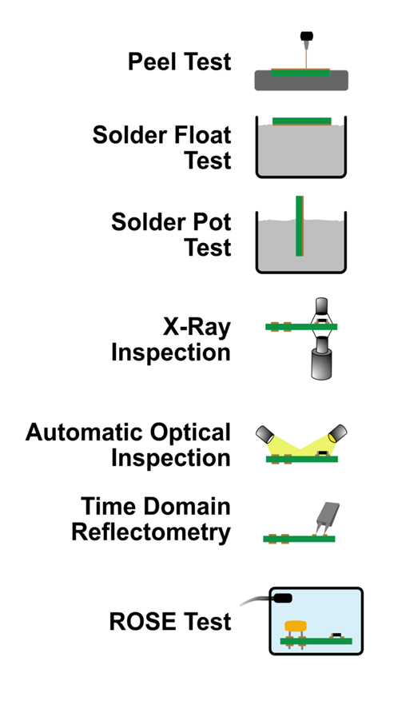
Fabrication Testing
Techniques

Slide 31
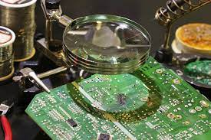
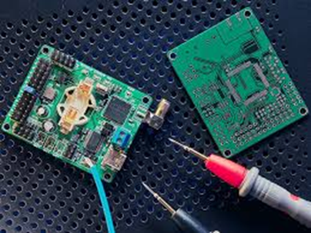
Manual Testing & Troubleshooting
Visual inspection
Flying Probe test (Manually)
Functional Testing (Specification & Requirements)

